Slide 1
BlackWall Protect an AI from going rogue via an AI
Parsa Besharat

Slide 2
CONTENTS
Introduction
Related work
Methodology – Risk Thermometer
Results
Integration
Conclusion
References

Slide 3
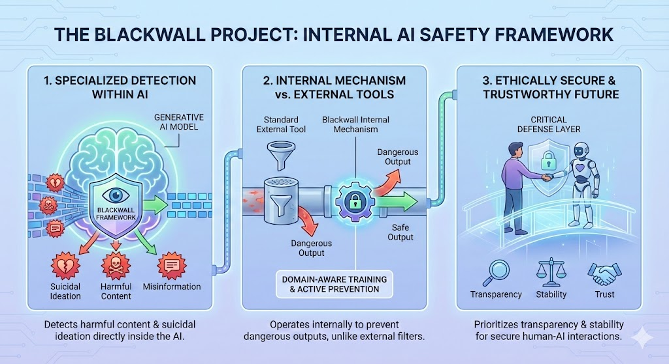
INTRODUCTION

Slide 4
Related work
Sawhney et al. (2020): Proposed STATENet (text + emotional history); effective but often confuses emotion with genuine suicidal intent. [1]
Pokrywka et al. (2024): Demonstrated GPT-4o outperforms DeBERTa; exposed that previous models failed on rare, severe cases due to statistical flaws. [2]
Yang et al.: Introduced a Hybrid RoBERTa model for Reddit; accurate, but computationally expensive, opaque, and limited by text length. [3]

Slide 5
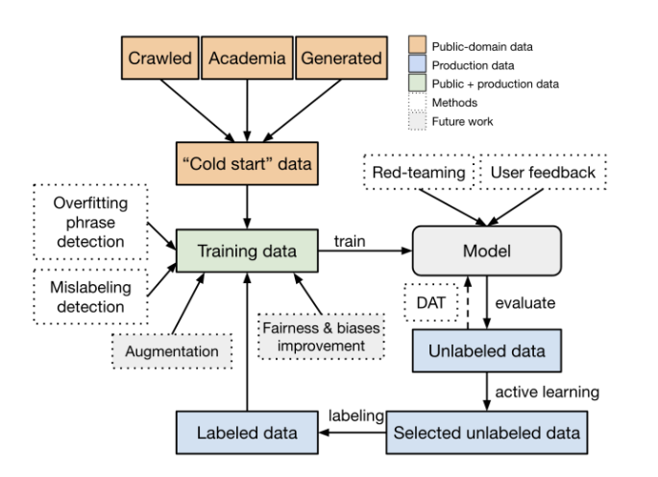
Related work
Markov et al: Created a robust moderation framework using synthetic data; performs well but remains vulnerable to noise and adversarial attacks.

Slide 6
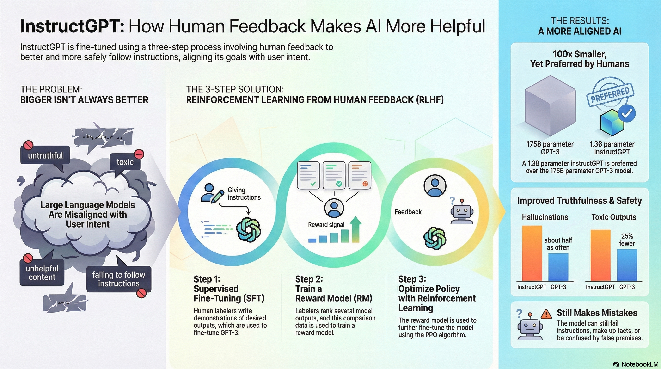
Related work
Ouyang & Wu (2022)

Slide 7
Methodology
Risk Thermometer

Slide 8
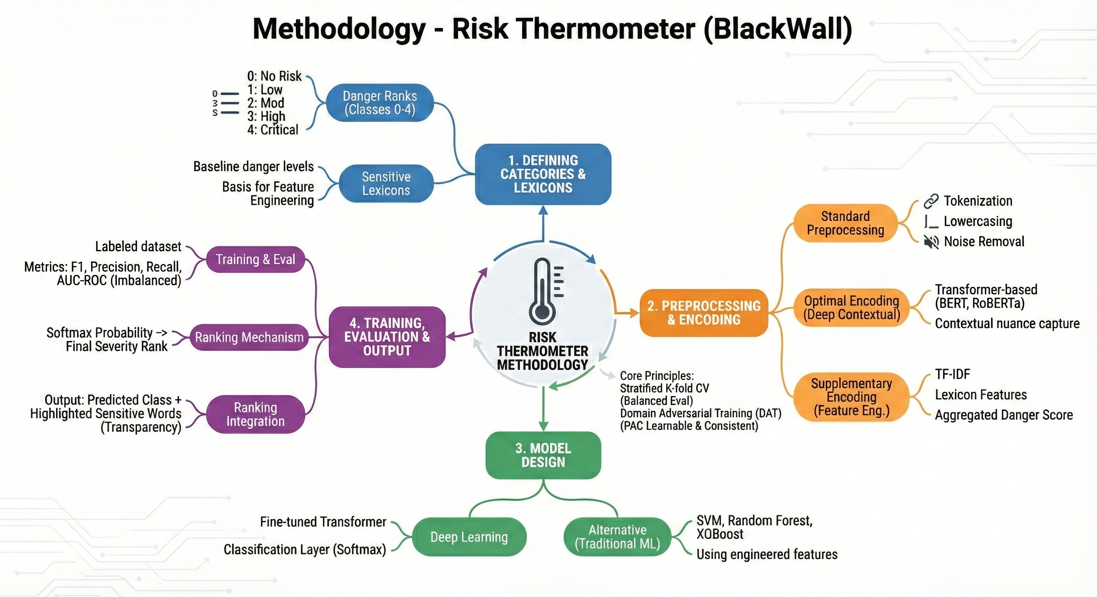
Methodology - mind map

Slide 9
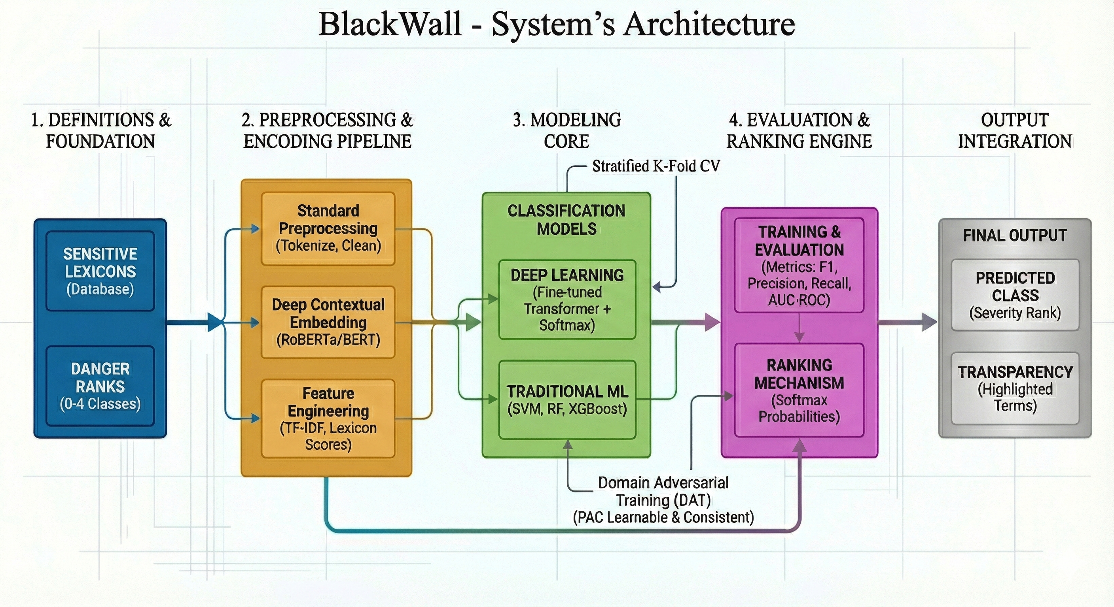
Methodology - Architecture

Slide 10
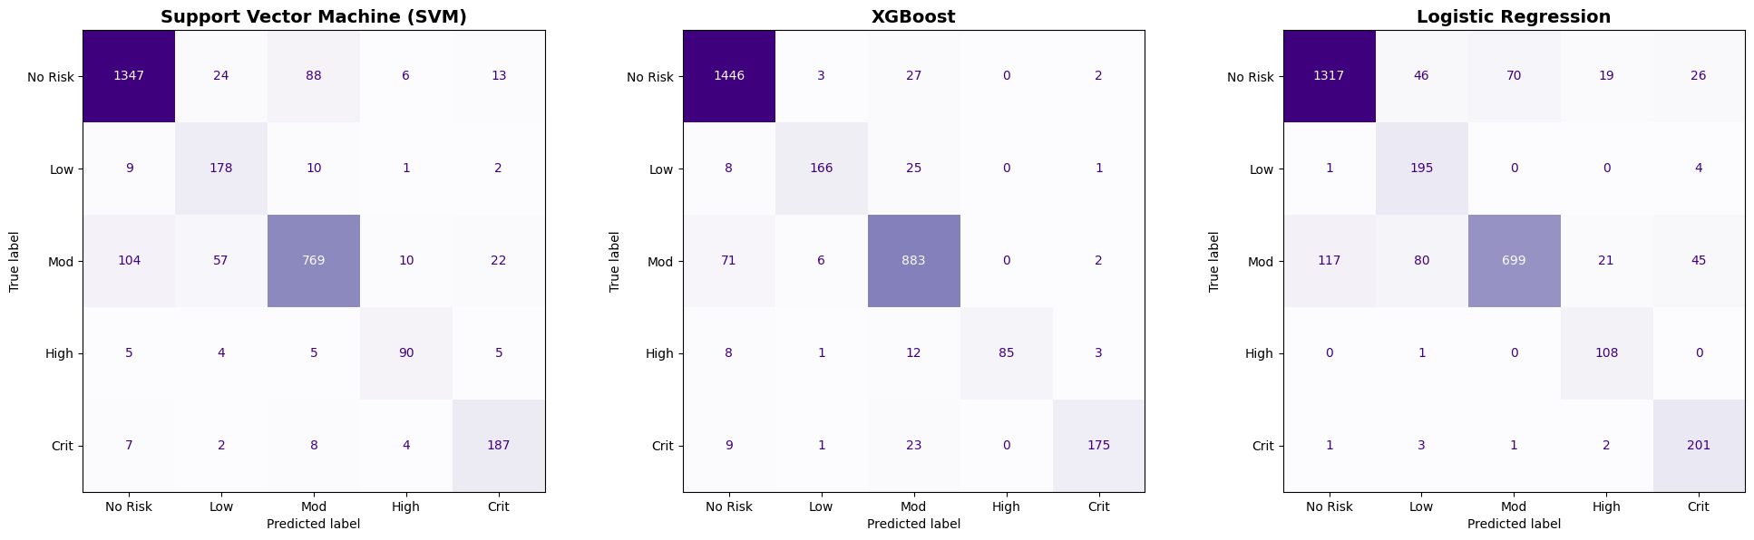
Results- SVM, XGBoost, LR

Slide 11
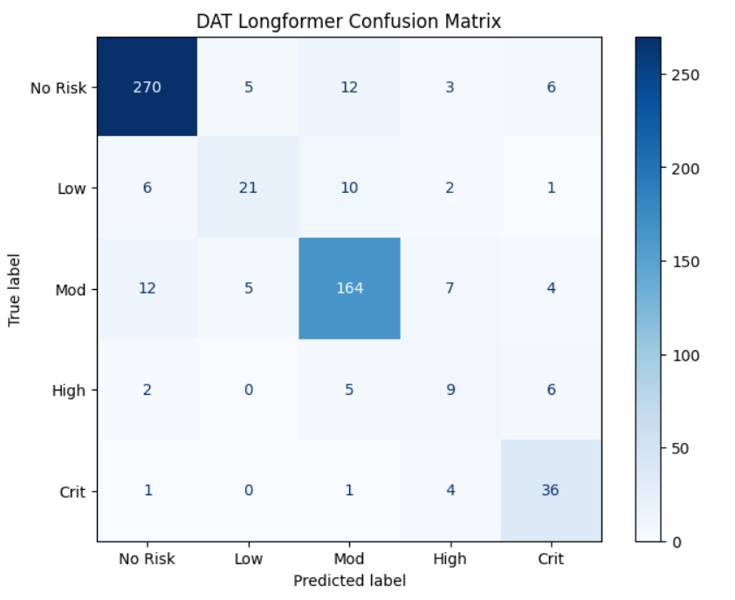
Results – DAT Neural network 5 Classes

Slide 12
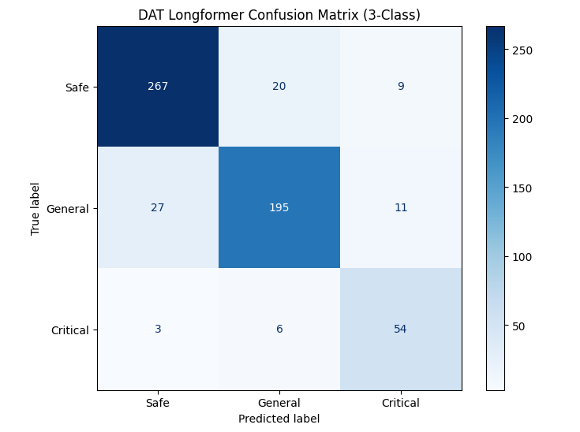
Results – DAT Neural network 5-Classes vs 3-Classes

Slide 13
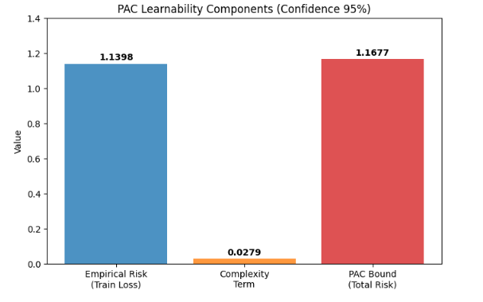
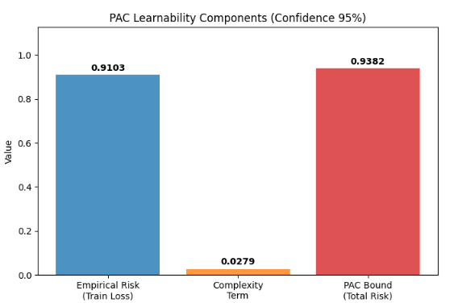
Results – DAT Neural network PAC learnability

Slide 14
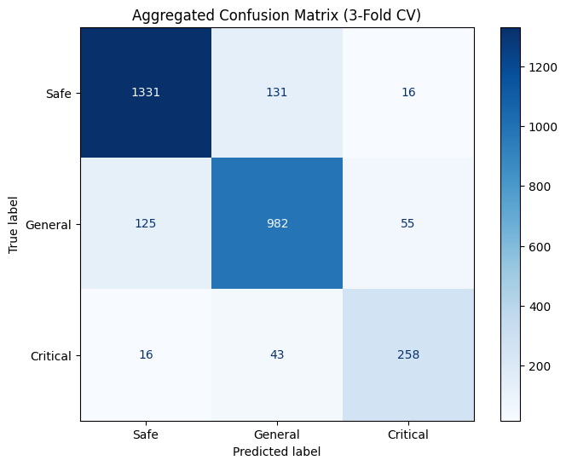
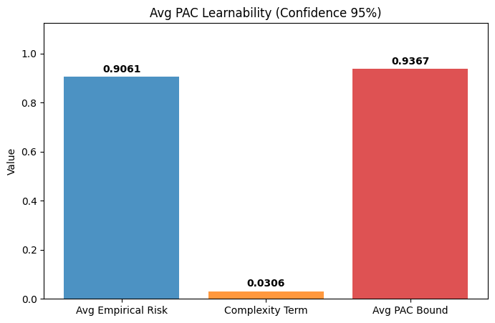
Results – DAT Neural network 3-Fold Cross Validation

Slide 15
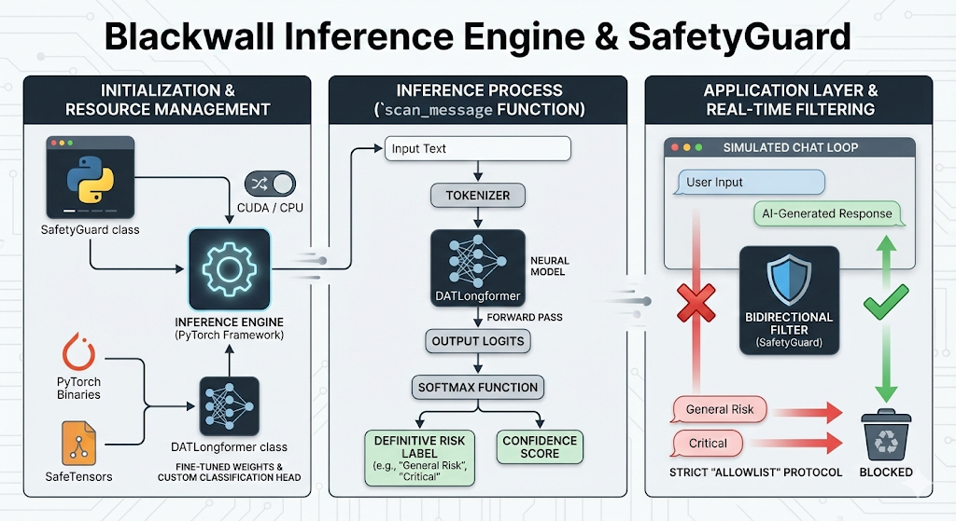
Integration

Slide 16
Conclusion
Despite the safety barriers applied by big tech, this project proves that AI models remain vulnerable to rogue behavior. However, we have demonstrated that these risks can be neutralized by an independent AI defense mechanism, effectively blocking harmful errors before they occur.

Slide 17
References
R. Sawhney, H. Joshi, S. Gandhi, and R. Shah, “A Time-Aware Transformer Based Model for Suicide Ideation Detection on Social Media,” Proceedings of the 2020 Conference on Empirical Methods in Natural Language Processing (EMNLP 2020), 2020. [Online]. Available: https://aclanthology.org/2020.emnlp-main.619/
J. Pokrywka, J. I. Kaczmarek, and E. J. Gorzelańczyk, “Evaluating Transformer Models for Suicide Risk Detection on Social Media,” in Proc. IEEE International Conference on Big Data (BigData), 2024. [Online]. Available: https://arxiv.org/abs/2410.08375
T. Markov, C. Zhang, S. Agarwal, T. Eloundou, T. Lee, S. Adler, A. Jiang, and L. Weng, “A Holistic Approach to Undesired Content Detection in the Real World,” in Proceedings of the AAAI Conference on Artificial Intelligence (AAAI), 2023. [Online]. Available: https://arxiv.org/abs/2208.03274
L. Ouyang, J. Wu, X. Jiang, D. Almeida, C. L. Wainwright, P. Mishkin, C. Zhang, S. Agarwal, et al., “Training Language Models to Follow Instructions with Human Feedback,” in Advances in Neural Information Processing Systems (NeurIPS), 2022. [Online]. Available: https://arxiv.org/abs/2203.02155
M. R. Meadi, T. Sillekens, S. Metselaar, A. van Balkom, and J. Bernstein, “Exploring the Ethical Challenges of Conversational AI in Mental Health Care: A Scoping Review,” JMIR Mental Health, vol. 12, e47723, 2025. [Online]. Available: https://doi.org/10.2196/60432
L. M. Weisker, AI-Driven Mental Health Chatbots: Perceived Empathy, User Satisfaction and Treatment Outcomes. Wiesbaden: Springer Gabler, BestMasters, 2025. [Online]. Available: https://link.springer.com/book/10.1007/978-3-658-50136-5
M. HassanPour Zonoozi and V. Seydi, “A Survey on Adversarial Domain Adaptation,” Neural Processing Letters, vol. 55, pp. 2429–2469, 2023. [Online]. Available: https://link.springer.com/article/10.1007/s11063-022-10977-5

Slide 18
THANK YOU
Parsa Besharat
parsa@hounaar.com
Hounaar.com

